Slide 1


Welcome to Team Ocean
Miss Hall
and
Miss Wong

Slide 2
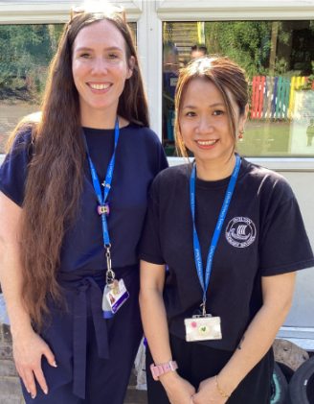
Meet the team
Miss Hall and Miss Wong

Slide 3
What our week looks like!
Monday – Game day in the morning, Books checked and changed on this day. Art and Sports Slam in the afternoon. Every other Monday afternoon Miss Twyman will teach Team Ocean.
Tuesday – bagel day and Mr Keam, Mr Arthur and Miss Knight in the afternoon - PE Day
Wednesday – wake and shake day and Music
Thursday – Forest school in the afternoons (This may change to a Wednesday!)
Friday –Chilton Hero assembly! Bouncy castle time and biscuit day!

Slide 4






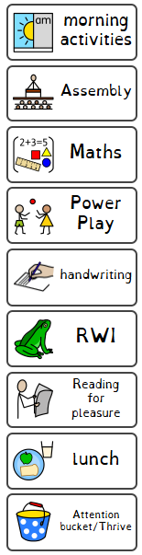
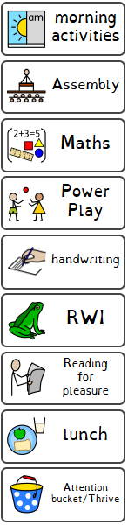

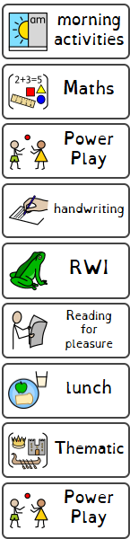


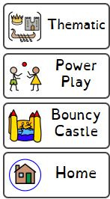


Life in year 1

Slide 5


Power Play

Slide 6

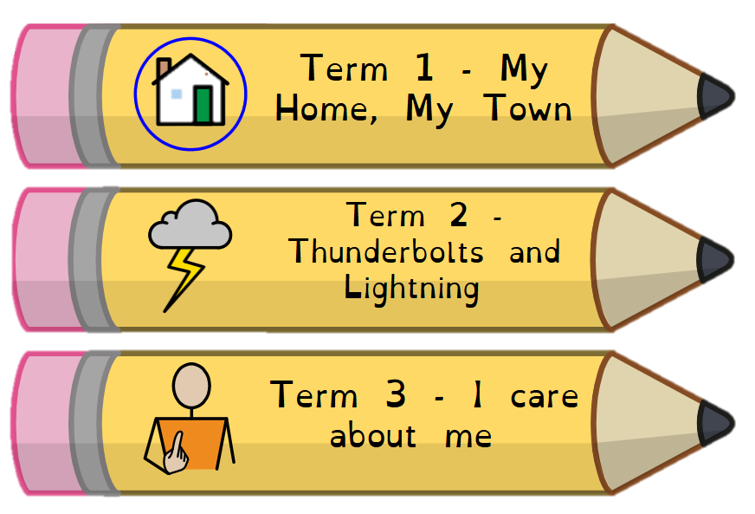

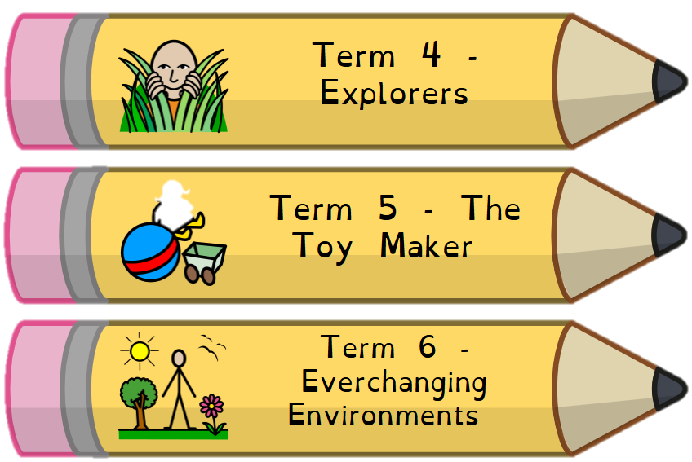

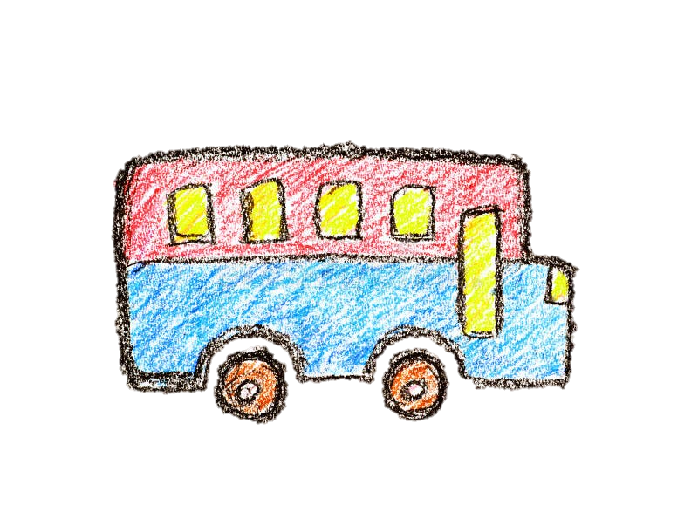
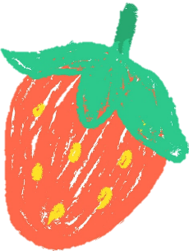




Thematic curriculum

Slide 7


PSHE & RE

Slide 8
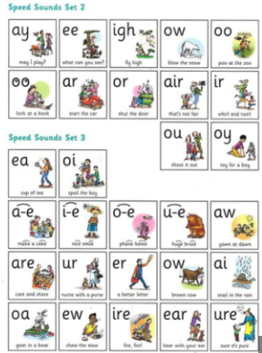
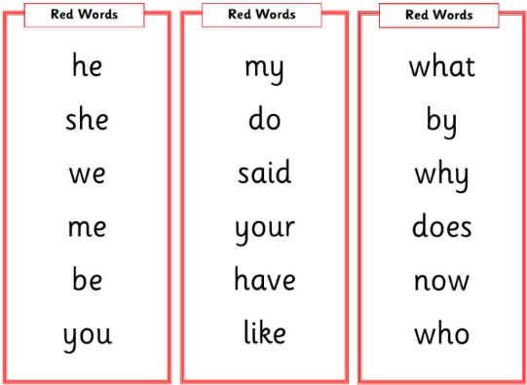


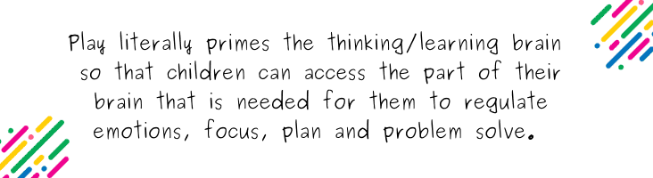
Helping at home!
-Reading, reading, reading ☺ Sounds and red words.
-love to learn
-https://www.chiltonprimary.co.uk/year1-blog-25/26
Chilton website,
Playing!

Slide 9
Communication
-Open door policy/come and talk before after school.
Eloise.hall@chiltonprimary.co.uk
I am contactable between 8am and 5pm Monday to Friday

