Slide 1

Phonics Screen
Phonics Screen - Monday 8 June 2026 - to Friday 12 June 2026

Slide 2

What is the phonics screen?
The phonics screen is designed to confirm whether children’s phonic decoding skills are at an appropriate standard. It will identify pupils who will need extra help to improve their decoding skills.
Decoding refers to words that can be ‘sounded out’ e.g. Cat; street; bench; loud; splint.
Irregular words that cannot be sounded out e.g. Come, the, some will not appear on the screen.

Slide 3
What is the phonics screen?
The check consists of 20 real words (dog, card, queen) and 20 non/made up words (dov, splog,cheen).
The non words are included as they are new words for all the children. This lessens the chance of a bias for children with a good vocabulary and good visual memory for words. It ensures it gives a true reflection of solely the child’s decoding ability.
The screen is administered by Miss Davey.
We complete the screens as a class regularly so the children are used to the format.

Slide 4
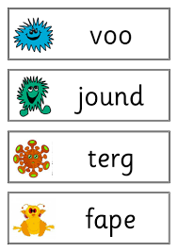
What is the phonics screen?
The children will read through cards with the words on to be screened. The non word cards have a picture of an alien .This ensures the children understand it is a non word.
The words become increasingly difficult as they go through the screen. Building up to reading words containing up to 6 sounds or words with more than one syllable.

Slide 5
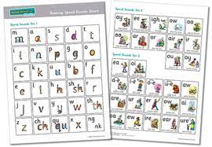
What the children will need to know...
Will need to recognise the sounds on the sound card and be able to blend them together to read real and nonsense words containing up to 5/6 sounds.
They will also need to be able to read words containing more than one syllable.

Slide 6
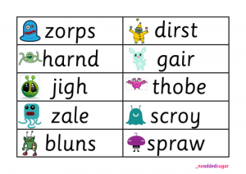
How can I help at home?
Recognising the sounds
3 steps on reading a word...
Recognising special friends or chatty friends
Fred talk – sound the word out
Read the word.

Slide 7
How can I help at home?
Whenever you read with your child try and go through their sounds and check they know them before they read to you.
This can just take 1 minute before you hear them read of pointing to the sounds and them saying them.
On the blog each week, we will put past phonics screen on for your child to practice at home.
Use the packs which we have made up to practise at home.
Play games like bingo, noughts and crosses with words to remind your children to check for special friends or chatty friends before sounding out.

Slide 8
What happens after the screen?
Your child will receive a score out of 40 depending on how many words they read correctly. You will be informed of their score in the end of year reports.
Previously a child who has a score or 32 or above is considered to have met the threshold.
If they do not meet the threshold DO NOT WORRY. We will plug the gaps that are shown in their learning during year 2.
Remember the screen only assesses their decoding ability and is not always a reflection of their reading ability as a whole.

