Slide 1



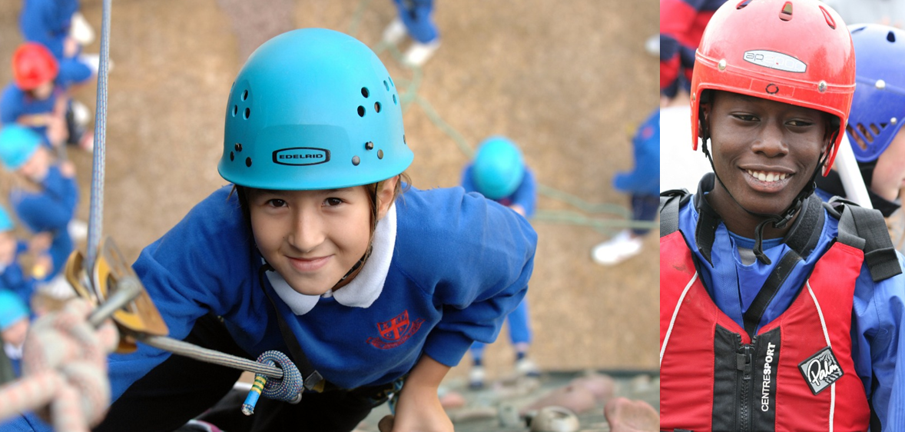
Carroty Wood 2026
Year 6 Residential Trip
One Childhood, One Chance

Slide 2
Agenda
Dates
Staffing
Accommodation
What to take
Food
Health
Daily Routine
Leaving and returning
Final reminders and additional info
Questions

Slide 3
Dates
Monday 14th September – Thursday 17th September

Slide 4
Provisional Staffing
From School:
Miss Isaac
Mr Arthur (first aider)
Mr Wheeler
Miss Cheshire
Miss Knight (first aider)
Mrs Bax
On Site:
Small number of highly trained male and female staff qualified in leading adventurous activities

Slide 5
Accommodation
Single sex bedrooms.
All children have to make their own beds from scratch.
School adults sleeping in same building.
Showers and toilets in same building.
Common room in same building.
Use of outdoor space for evening activities.
Use of canteen area in same building.

Slide 6
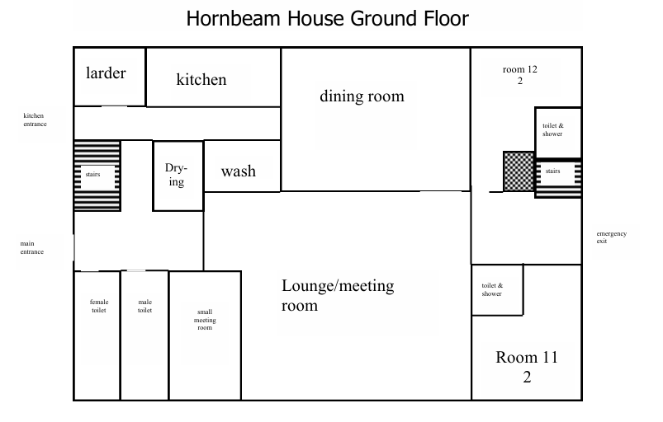

Slide 7
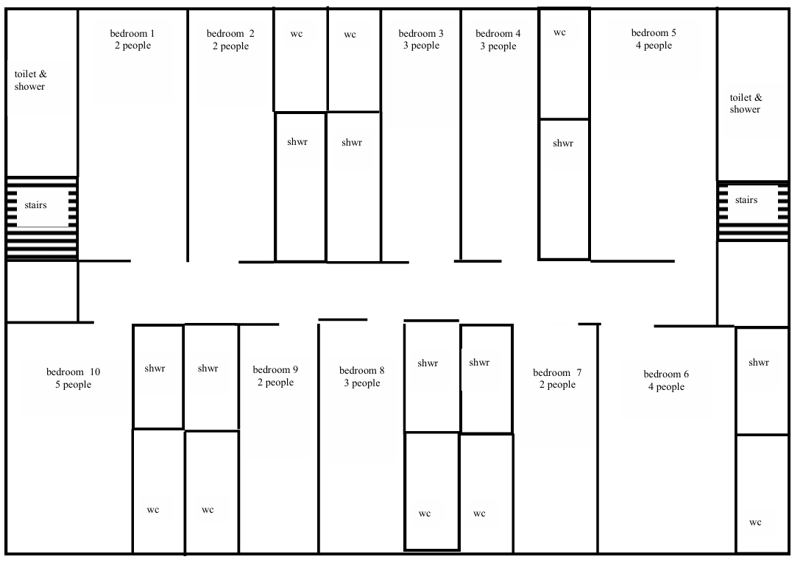

Slide 8
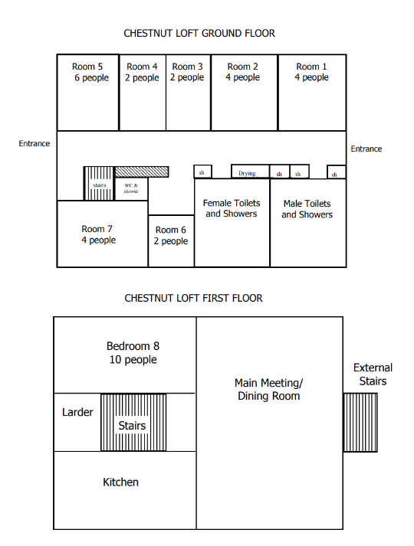

Slide 9
What to take for activities
All day time clothing should be suitable for outdoor, physical activities
T-shirts and jumper/fleece – layers!
Jeans, jogging trousers (must be warn for raft building)
Warning – clothes will get wet and mucky
At least 2 pairs of trainers – one for outdoor and one for indoor (crocs not allowed for activities).
Wellies or boots.
Waterproof coat.
Lots of socks.
Hat, gloves etc.
Change of clothes for evening – nothing too smart!
Hair ties
A few empty black sacks to put wet clothing in to.
Towel
Swimming shorts/costumes

Slide 10
What to take ..everything else
Change of clothes for evening (warm and comfortable)
Toiletries
Towel
Book, notepad etc with pencil/pen etc
Rucksack or similar –use this as hand luggage on Monday
A torch
Plastic bags for dirty/wet clothes or shoes
NO sweets!
NO handheld games!
NO mobile phones!

Slide 11
Food
Monday (departure day) – children need to bring a packed lunch to eat on arrival. Other than that all meals provided
Plenty of food – they will not go hungry!
Wide range for every meal
All dietary requirements catered for –please inform us of any allergies (see key survey form)
No need to send supplies!

Slide 12
Medical/health
All safety equipment for activities provided by Carroty Wood and checked by trained staff.
Medication form explaining dosage etc. (see key survey form)
Medication labelled and handed in to Miss Knight on Monday morning
All medical information held in confidence
Travel sickness tablets for return journey (labelled and hand to Miss Knight on Monday morning)
All activities fully risk assessed

Slide 13
Behaviour
Safety of all children and staff is paramount.
We all want to be safe and have fun!
Behaviour expectations
Be ready, be respectful, be safe – The Chilton Way!
Praise, Praise, Praise
Usual behaviour policy will be followed
  1. Praise and de-escalating techniques used (distraction, humour, change of adult etc)
  2. Verbal reminder of appropriate and acceptable behaviour.
  3. Verbal warning and reminder of consequences.
  4. Time out (for a set amount of time) from activity for child to calm down and make changes to behaviour. This is also to ensure the safety of other children and adults.
  5. Exclusion of child from the remainder of the activity.
Unacceptable and unsafe at Carroty Wood
In the unlikely case of children not following the Chilton Way, parents will be contacted and a safety plan will be implemented.
  -causing unprovoked physical harm on another child or member of staff
  -persistently ignoring instructions given by staff (Chilton and Carroty Wood)
  -leaving the Carroty Wood site without permission
  -using equipment in an unsafe way to harm others (ie archery bow and arrows)
  -leaving staff supervision without permission (ie during night walk, when off site, when participating in adventurous activities or during the night)

Slide 14
Daily Routine
7am Wake up, showers etc.
8.00am Breakfast
9.15am Morning Activities (including a break)
13.00pm Lunch
2.00 – 5.45pm Afternoon Activities (including a break)
Showers, changing etc.
6.00pm Dinner
7.30pm – 8.30pm Evening Activities
9.30pm/10.00pm Bedtime

Slide 15
Evenings:
Monday/Wednesday – Swimming or Night walk
Tuesday – Campfire

Slide 16
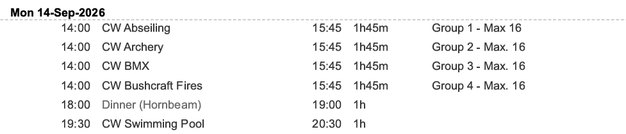
Time table

Slide 17
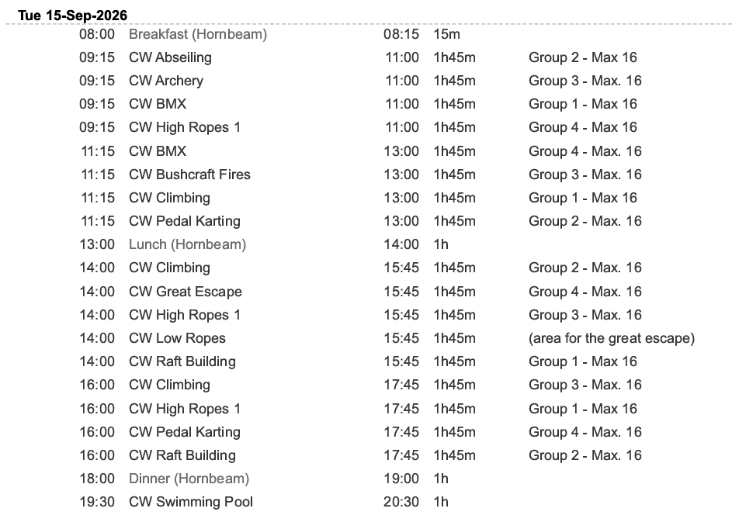
Time table

Slide 18
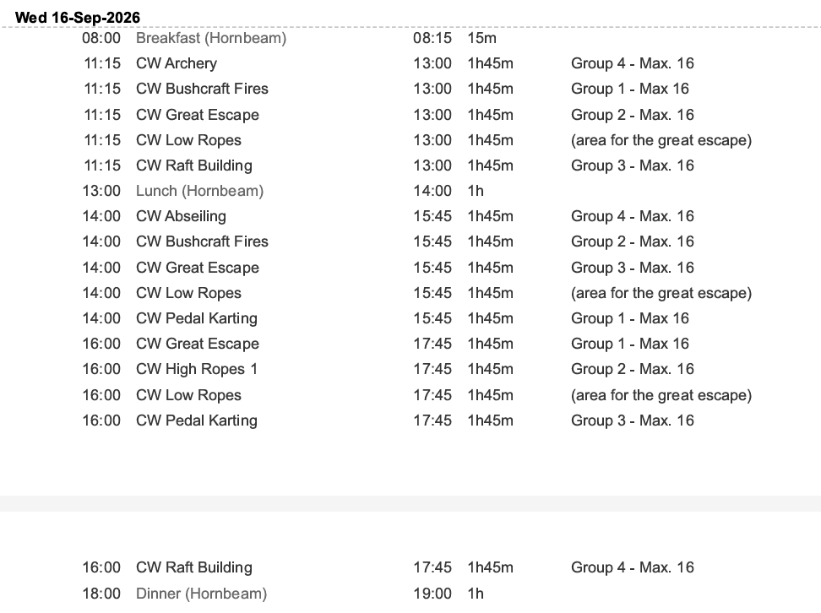
Time table

Slide 19
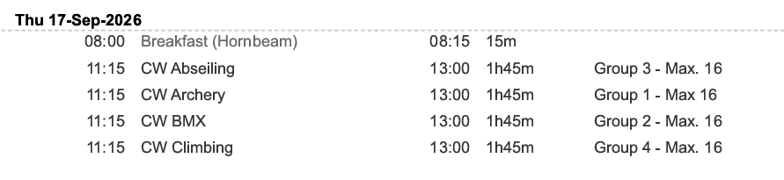
Time table

Slide 20
Leaving and Returning
Monday:
Arrive at school between 8.30am and 8.45am and come to classrooms
Hand in any named medicines to Miss Knight who will be sat outside classrooms (must have completed key survey medical form)
Take any travel sickness medical with parent on arrival in school
Wearing non-uniform
Leave school around 10.45am
Travel to Carroty Wood. Find out groups and rooms.
Welcome talk and tour, make beds.
Lunch in Carroty Wood grounds – children to bring own packed lunch
Afternoon adventurous activities
Dinner
Swimming/Flag Raiders and other games

Slide 21
Leaving and Returning
Thursday:
Breakfast – pack up all belongings
Morning activities
Lunch
Last check for all belongings and leave
Arrive back at school in time for usual pick up at 3.15

Slide 22
Final reminders and additional information
Fill in the medical consent forms and return as soon as possible (key survey)
Make us aware of any dietary requirements (key survey)

Slide 23
Questions
Any questions?

