Slide 1
Secondary School Application Process
Mrs Rowland-Hill
(Trust T&L and Year 6 Lead)

Slide 2
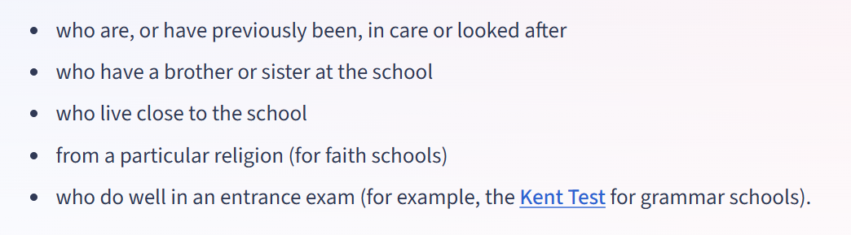
Applying for a Year 7 place
Deadline for ALL applications is: Monday 2nd November - https://www.kent.gov.uk/education-and-children/schools/school-places/secondary-school-places
Name 4 preferred secondary schools
Visit as many schools as possible with your child
Check the school’s admission criteria (this can be different for all schools)

Slide 3
How to choose a school
Think about:
  Visiting schools
  Distance from your child’s address
  Transport to school
  Support for your child. Contact the school’s SENCO
  Challenge for your child (secondary schools offer grammar/scholarship streams for challenge)
  All schools (including grammar schools) follow the same National Curriculum

Slide 4
Open Days Coming Up..
Hartsdown – 12th October
King Ethelbert School – 12th Oct
Chatham House – 14th/16th/17th October
Sandwich – 15th October
Sir Roger Manwood's – 16th October
St George's – 21st October
Dane Court – 21st October
Royal Harbour Academy – Contact to make an appointment
Ursuline – Contact to make an appointment

Slide 5
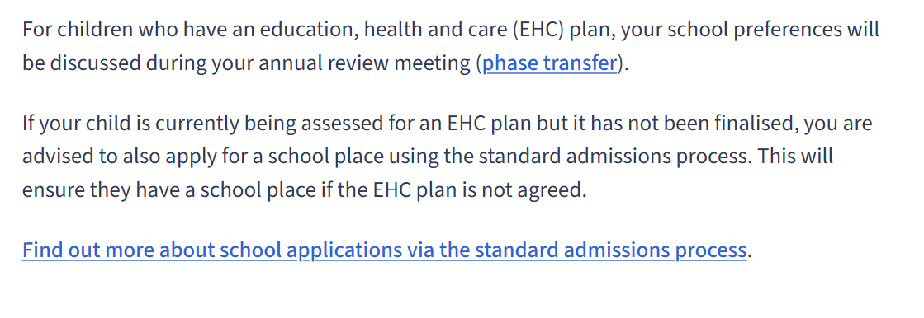
  Applying for a school place - EHCPs
  For help and advise please contact your school SENCO
  Chilton – Carly Reavill
  Upton – Emma Hill
  https://www.kent.gov.uk/education-and-children/special-educational-needs-and-disabilities/school-aged-children/school-options-for-your-send-child/choose-a-school-for-your-child-with-send

Slide 6
Application decisions
  Allocated schools are announced on:
  1st March via an email directly to you. You can also view your offer online at KCC here - https://kent.cloud.servelec-synergy.com/Synergy/Admissions.aspx

Slide 7
  What if you do not get the secondary school you wanted?
  Do not panic
  Accept the school you have been allocated
  Appeal directly to the secondary school of your choice. You will be placed on a waiting list. This can take time.
  Some schools may ask for more information from you to support your appeal.
  This process can take some weeks – all schools are different. Remain in contact with them.

Slide 8
Kent Test Results
Kent Test Results come to you on:
Thursday 15th October.
Results will state the letters H or G on the results.
H = High school place / G = Grammar place
Open Days
Chatham House - 20th / 22nd October https://www.ccgrammarschool.co.uk/home/open-week-events-october-2026/
Dane Court – 21st October https://www.danecourt.kent.sch.uk/admissions/year-6-open-day-wednesday-21-october-2026
Sir Roger Manwood’s 16th October https://www.manwoods.co.uk/attachments/download.asp?file=636&type=pdf

Slide 9
Appealing for a grammar school place
Deadline for ALL applications is:
Monday 2nd November
https://www.kent.gov.uk/education-and-children/schools/school-places/secondary-school-places
Name 3 preferred secondary schools with your 4th school choice being a grammar
This must be your fourth choice if you have been given an H in the Kent Test result.

Slide 10
  Appealing for a grammar school place
  Do not panic
  Accept the school you have been allocated
  Parental Appeal
  Appeal directly to the grammar school you want. Check their admission criteria as they are all different. Each grammar school asks for different information. All parental appeals will be given a date for each appeal. Additional information (mock SATs results, reading ages, letters can be provided to support your parental appeal).

Slide 11
  Important dates
  Kent Test Deadline – 15th October
  Year 7 application deadline - 2nd November
  School allocations emailed to you - 1st March
  Appeal deadlines – these are all different depending on the school you are appealing for. Contact the school directly.

Slide 12
Contact
Helen Rowland-Hill – Trust Teaching and Learning Lead and Year 6 Lead
helen.rowland-hill@chiltonprimary.co.uk
KCC - https://www.kent.gov.uk/education-and-children/schools/school-places/secondary-school-places#accordion-item-2
Any questions?

